Slide 1






车和家e-APQP方案
CHJ e- APQP Solution

Slide 2
Agenda
奥曼克公司介绍Introduction to Omnex (5 mins)
方案和需求概述Overview on Solution & Requirements(30 mins)
对车和家需求的理解Understanding of CHJ Requirements
需求对应的系统功能Demand-relevant system functions
奥曼克及其解决方案的优势Omnex and its solution advantages
Omnex认为的其他重要的内容Other important content that Omnex suggestion
问&答 下一步 Q & A, Next Steps

Slide 3

奥曼克的历史 History of Omnex
Founded in 1985建立于1985
Headquartered in Ann Arbor, Michigan with offices in major global markets总部设于美国密歇根州安阿伯市，并在全球所有主要市场都设有办事处
In 1995-97 provided global roll out supplier training and development for
Ford Motor Company establishing offices in Latin America and Asia
在 1995-97 为全球供应商提供培训并对福特汽车公司做出改进，在拉丁美洲和亚洲都设有办事处
Trained more than 90,000 individuals in over 30 countries培训超过30多个国家，90,000多人。
Former Delegation Leader of the International Automotive Task Force (IATF)
国际汽车工作组（IATF）前任代表团团长
Served on committees that wrote QOS, ISO/TS16949, ISO9001:2000, QS-9000 and
it’s Semiconductor Supplement, ISO IWA 1 (ISO9000 for healthcare)
在委员会参与编写QS-9000,QOS和ISO/TS 16949的半导体补充说明。
Member of AIAG manual writing committees for FMEA, SPC, MSA, Sub-tier Supplier Development,
Error Proofing, and Effective Problem Solving (EPS)
是AIGA编写委员会的成员，负责FMEA, SPC, MSA, 防错纠正和有效解决问题(EPS)方面
On the ISO writing committees for ISO 9001, ISO 14001, ISO 45001, and ISO 13485
参与ISO 9001, ISO 14001, ISO 45001, and ISO 13485 编写委员会
SME for AQP and PPAP to International Aerospace Quality Group (IAQG)
AQP和PPAP的中小企业到国际航空质量组织（IAQG）
One of the first to fully integrate Lean and Six Sigma 第一个完全集成精益和六西格玛
ISO 9001-certified for training development, training delivery and consulting
ISO 9001-认证的 培训改进, 交付培训和咨询公司。
v

Slide 4
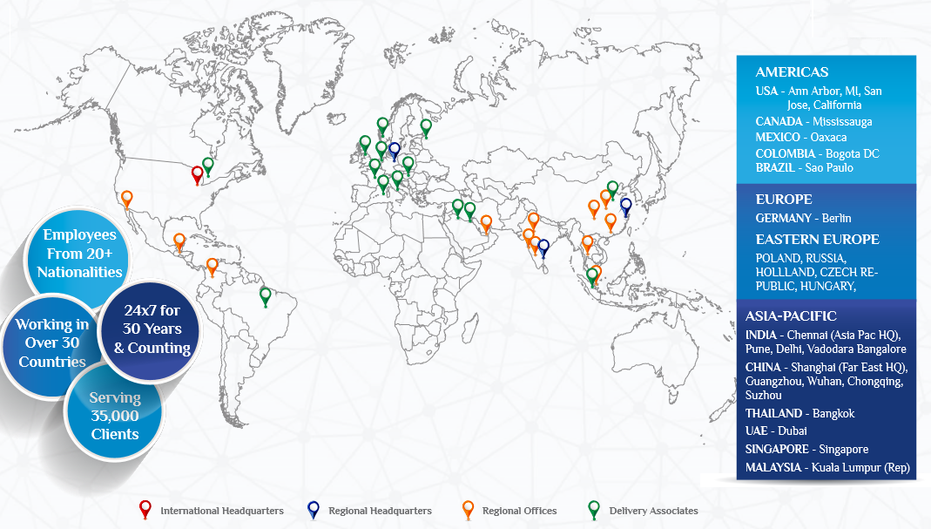
奥曼克全球办公室Omnex worldwide offices
v

Slide 5

















奥曼克集团快照 OMNEX GROUP SNAPSHOT
Key Business Activities主要业务
OMNEX CONSULTING
OMNEX SYSTEMS
OMNEX PLANTECH
Enterprise
Management Systems
Enterprise
Management Systems
Auditing Services
Lean Six Sigma
projects
Lean Six Sigma
projects
Supplier Development
Strategy
Consulting
Strategy
Consulting
Product/Process
Conformity (PQAS)
Supply Chain
solutions
Outsourced/ Staffing
Services
Design/ R&D
workshops
Project Management
Public Training &
E-learning
Learning Academy
v

Slide 6

奥曼克快照OMNEX GROUP SNAPSHOT

Slide 7
企业实施 Enterprise Implementations
C
U
S
T
O
M
E
R
N
E
E
D
S
C U
S
T
O
M
E
R
F
U
L
F
I
L
L
M
E
N
T
ENTERPRISE
QUALITY
(EwQIMS® TM)
PLM
CRM
ERP
SUPPLIER
v

Slide 8
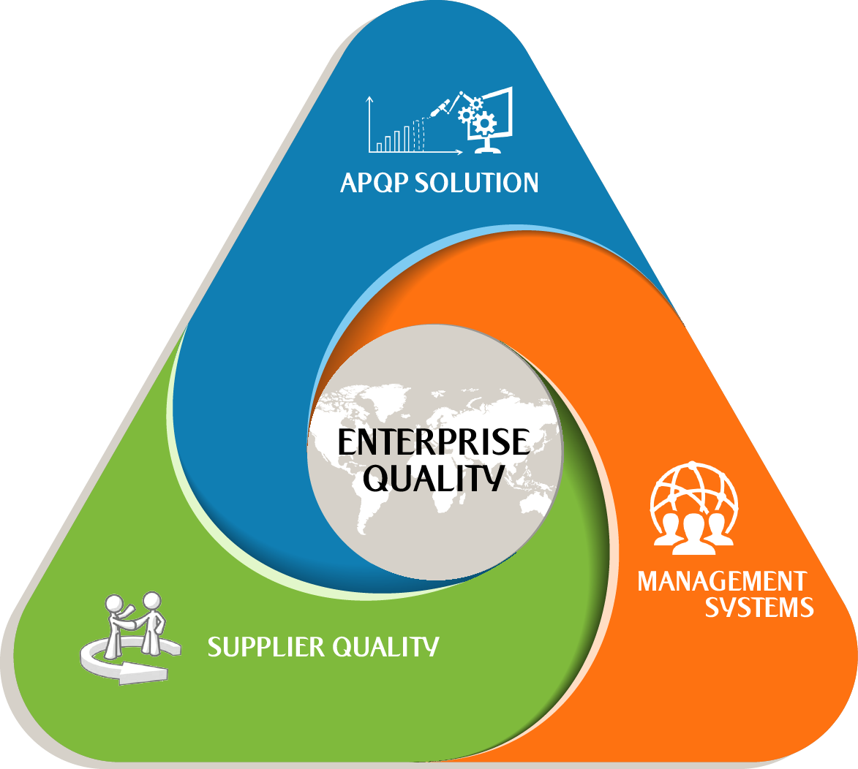

企业级质量Enterprise Quality
Enterprise-wide Quality and
Integrated Management System
v

Slide 9
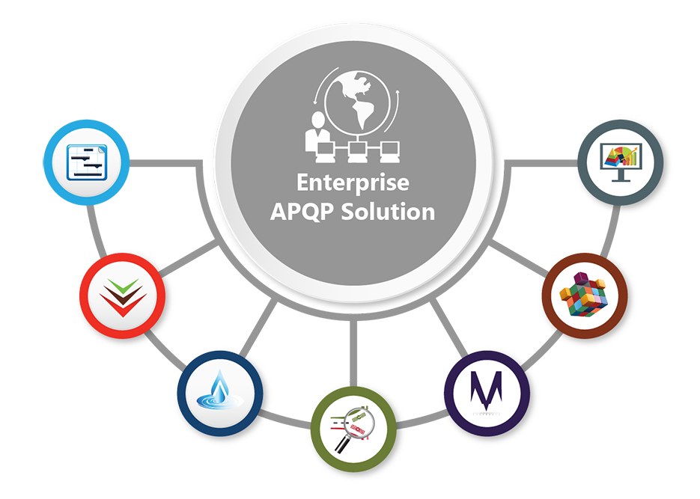
企业级APQP 方案 Enterprise APQP Solution
Managing integrated APQP/PPAPs, Safety Plans, and Safety Cases for organization and suppliers
Top management in implementing customer-focused continual improvement and tracking performance
Manage your Voice of Customer & Requirements through out the System, Sub-System & Components – functions, requirements, and characteristics
Conducting integrated problem solving for internal quality, external quality, suppliers etc.
Manage your gages and performs all MSA Studies - Bias, Calibration, GR&R, and Stability Studies for Variable and Attribute gages.
Linked DFMEA, Test Plans, Process Flow, PFMEA, Control Plans and Work Instructions by Product and Process Families
Manage your In-Process, Receiving & Final inspections

Slide 10


供应商质量管理套件 Supplier Quality Management Suite
Supplier
Metrics
New Product
Development –
Project Planning/
Project Reviews
Supplier
Audits
Supplier
Quality
Mgmt
Supplier First
Article/PPAP
Problem
Solving

Slide 11












Enterprise-wide Quality Integrated Management System and
Enterprise Functional Safety
Managing integrated APQP/PPAPs, Safety Plans, and Safety Cases for organization and suppliers为组织和供应商管理综合APQP / PPAPs，安全计划和安全案例
Manage your Voice of Customer & Requirements through out the System, Sub-System & Components – functions, requirements, and characteristics
通过系统，子系统和组件 - 功能，要求和特性来管理您的客户声音和需求
Linked DFMEA, Test Plans, Process Flow, PFMEA, Control Plans and Work Instructions by Product and Process Families
通过产品族和工艺族的结构，提供链接的设计FMEA, 检验计划，流程图， 过程FMEA, 控制计划和作业指导书
Managing Enterprise QMS (ISO 9001 and ISO TS/IATF 16949) including Functional Safety Management System processes (ISO 26262)
管理企业质量管理体系（ISO 9001和ISO TS / IATF 16949），包括功能安全管理体系流程（ISO 26262）
Integrated Audit Management - ISO TS/ IATF 16949, ISO 9001, AS 9100, ISO 14000, CMM, CMMI
综合审计管理 - ISO TS / IATF 16949，ISO 9001，AS 9100，ISO 14000，CMM，CMMI
Manage your gages and performs all MSA Studies - Bias, Calibration, GR&R, and Stability Studies for Variable and Attribute gages.
管理您的量具并执行所有MSA研究 - 偏差，校准，GR＆R和变量和属性量具的稳定性研究。
Manage your In-Process, Incoming/Receiving & Outgoing/Final inspections管理您的内部流程，来料/接收和出货/最终检查
Conducting integrated problem solving for internal quality, external quality, suppliers etc.为内部质量，外部质量，供应商等提供综合问题解决方案
Manages Total Productivity Maintenance of your plant(s). Addresses all TPM requirements管理您的工厂的总生产力维护。 解决所有TPM要求
Training management and objectives deployment from Corporate to employees从企业到员工培训管理和目标部署
Top management in implementing customer-focused continual improvement and tracking performance
最高管理层实施以客户为中心的持续改进和跟踪绩效
Manufacturing Controls and Traceability of ASILs to Control Plan, Inspection Plans, and Inspection Sheets
生产控制和可追溯性的ASILs控制计划，检查计划，和检查表。

Slide 12
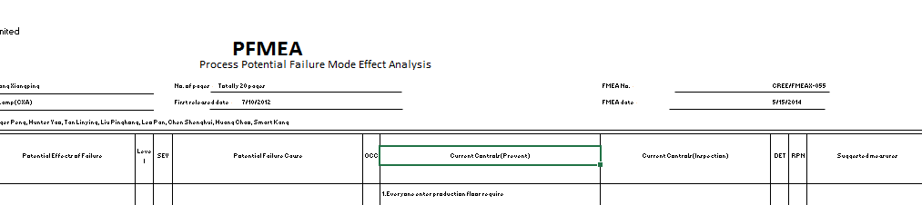

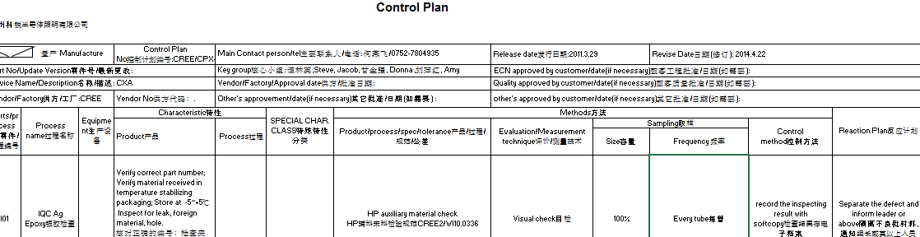
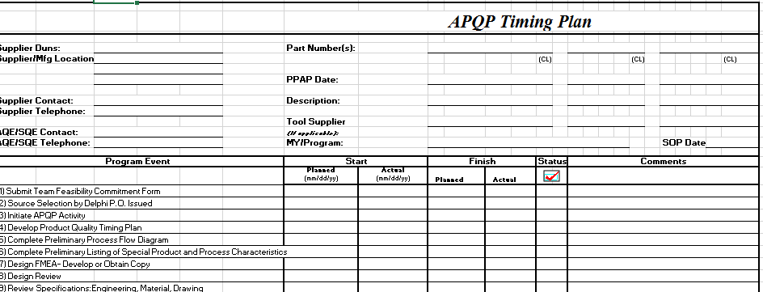
Managing APQP using ‘SPREADSHEETS’ can be a challenging experience 使用'SPREADSHEETS'管理APQP可能是一个具有挑战性的经历
APQP
Time plan
DFMEA
And more….
DVPR
Meeting
Process Flow
Control Plan
PFMEA
v

Slide 13
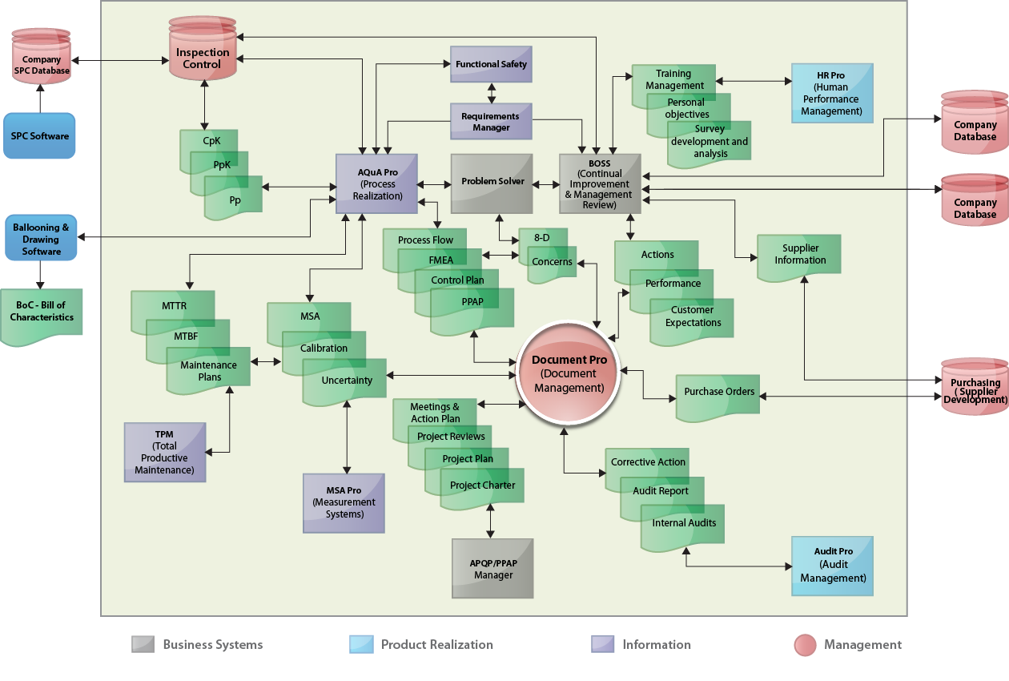
EwQIMS®: Complete Architecture完整的体系结构
v

Slide 14

Features common across the board
全面通用的特性
Enterprise wide Web-based system基于网页的企业质量管理系统
Manage multiple sites管理多个站点
Support for multi-language and multi-date. 支持多种语言和多种日期格式
Integrated with Email notification with Outlook Integration, reminders and escalation services 结合电子邮件通知和提醒
Ready to integrate with legacy and ERP systems可以与ERP系统整合
One point User Authentication一个关键的用户身份验证
Role-based Security基于角色的安全性
Fully Integrated solution – Lean data entry完全集成的解决方案-精益的数据 输入
v

Slide 15



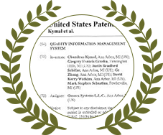


Our Awards and Accolades我们的奖项和赞誉
Six other patents pending regarding risk management and enterprise compliance
v

Slide 16



Current Target Customers目前的目标客户
KEY INDUSTRIES
OTHER INDUSTRIES
AUTOMOTIVE
AEROSPACE
ELECTRONICS/ SEMICONDUCTOR
JEWELLERY
WIND ENERGY
HOME APPLIANCES
FUTURE INDUSTRIES
MEDICAL DEVICES
FOOD & RETAIL

Slide 17






































EwQIMS Software Customers – Worldwide全球范围内的软件客户
v
100s of customers across the globe and counting………

Slide 18
车和家需求&奥曼克方案
CHJ Requirements vs OMNEX Solution

Slide 19

CHJ Requirements / 车和家需求

Slide 20
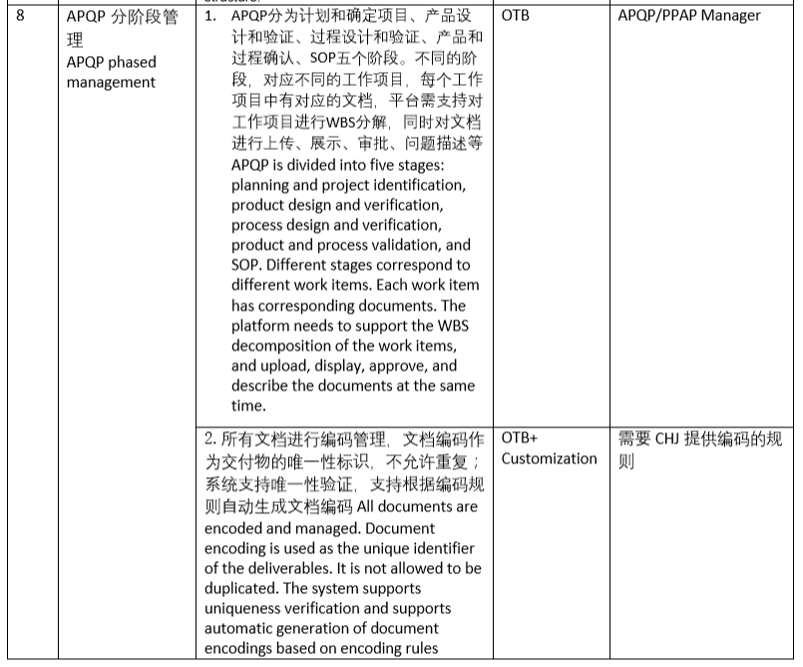
需求Requirement #1 & # 8
No 序号 | Requirement需求 | Requirement description | Conformance是否满足 | Remark 备注
1 | APQP分阶段管理 APQP phased management | 对APQP五个阶段工作项目进行WBS WBS for APQP five-phase work projects | OTB | APQP/PPAP manager

Slide 21
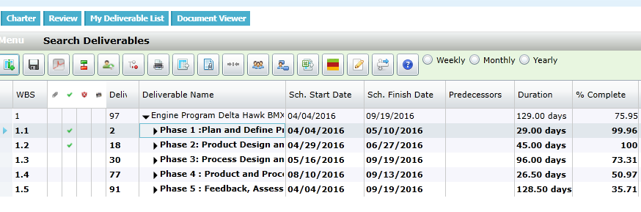
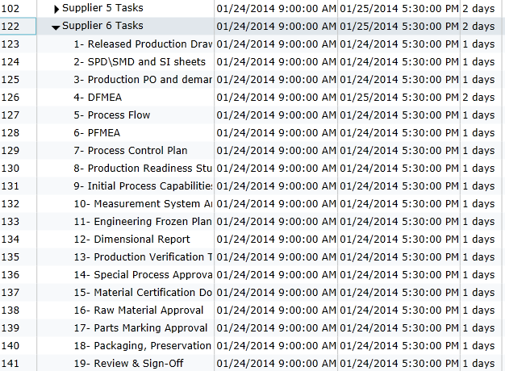
APQP Projects
PPAP Projects

Slide 22
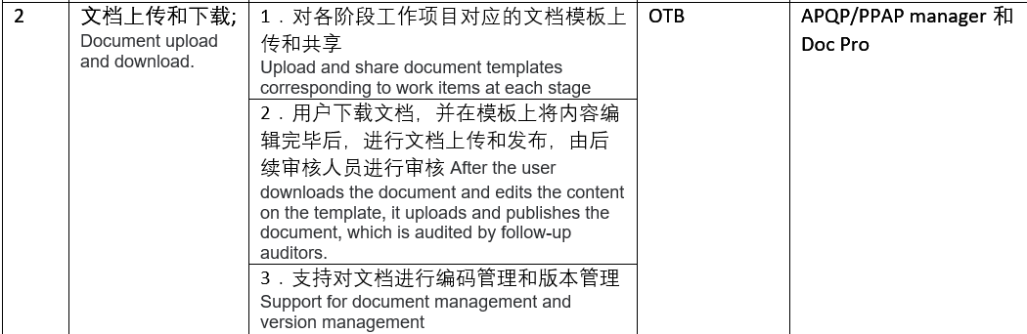
需求Requirement #2

Slide 23
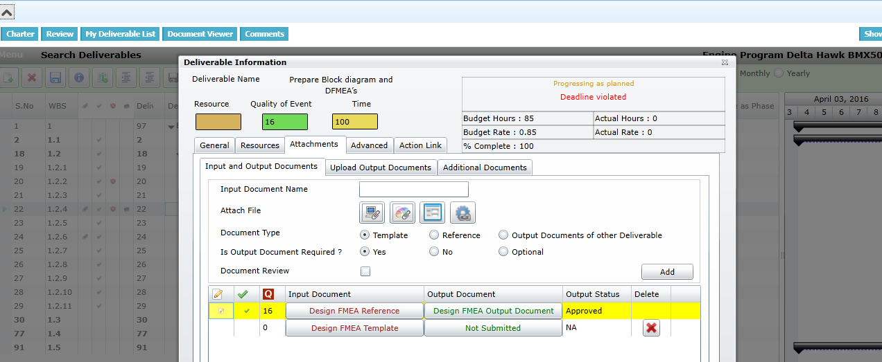

Slide 24
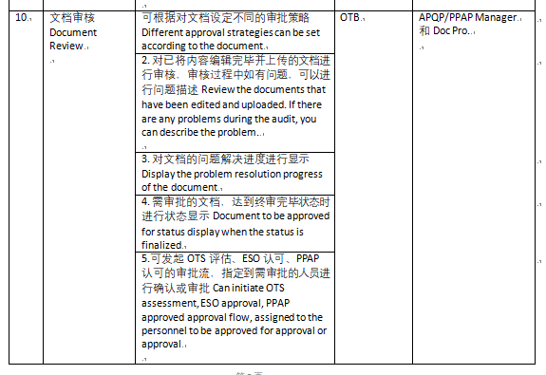
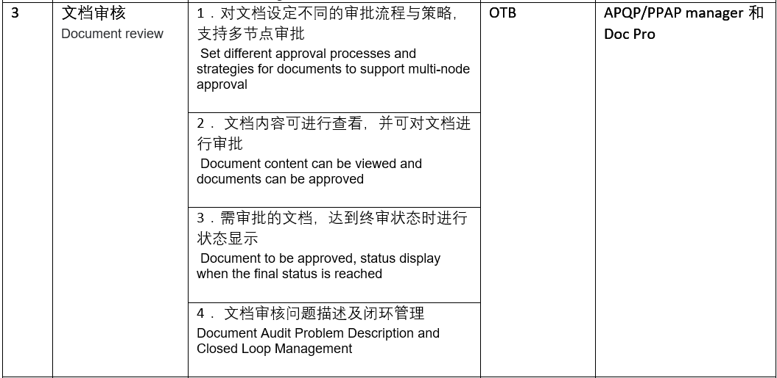
需求Requirement #3 & #10

Slide 25
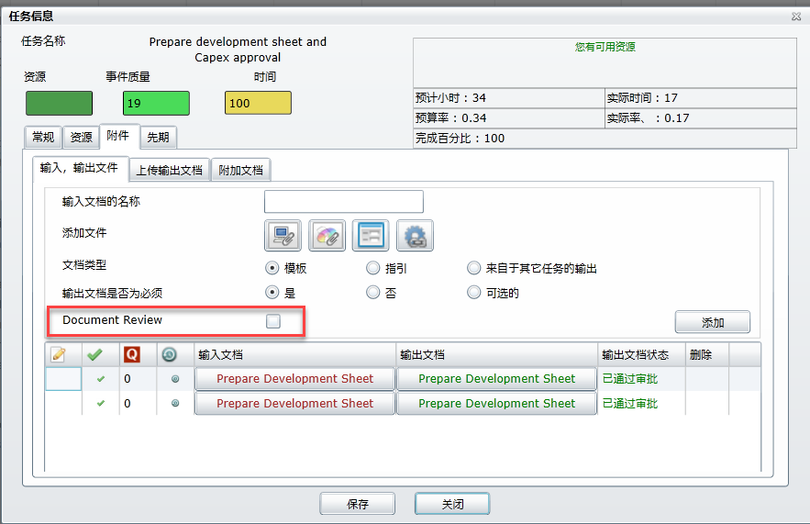
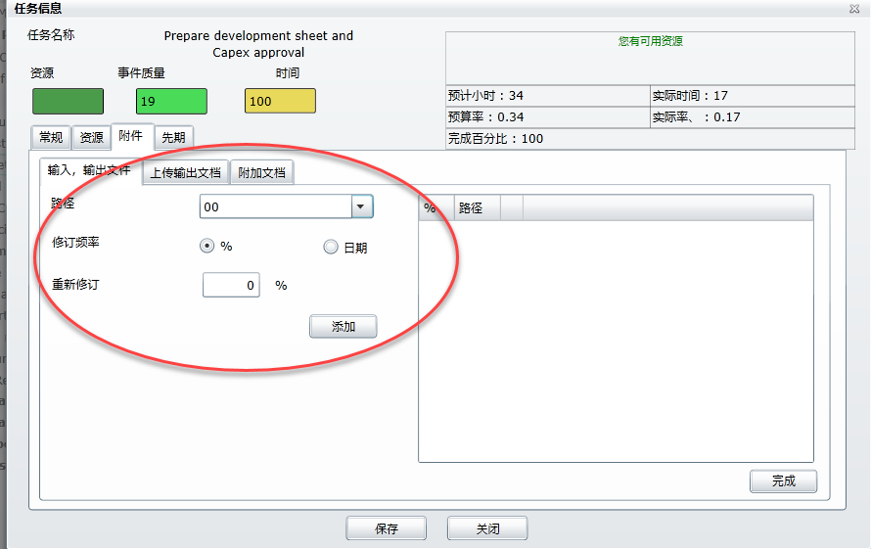

Slide 26
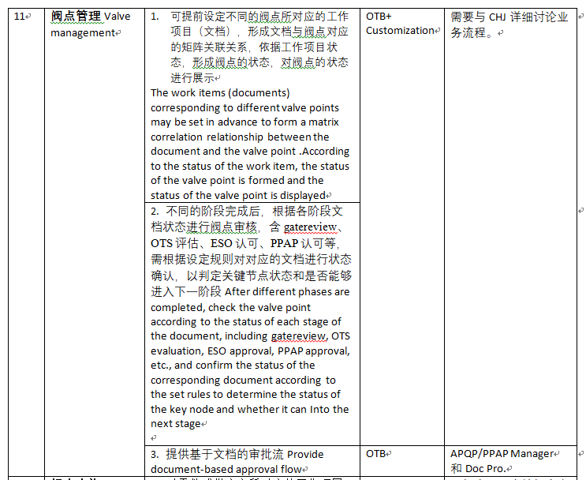
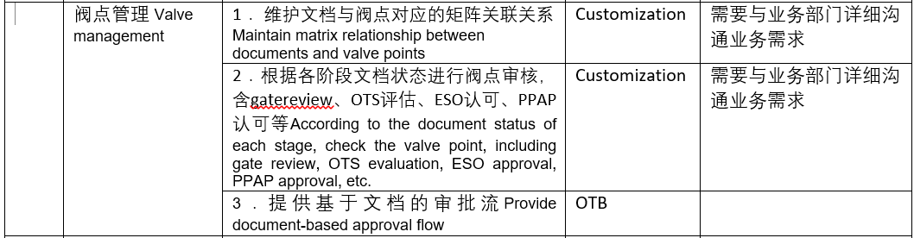
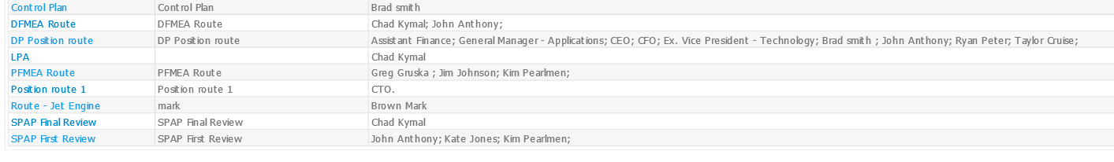
需求Requirement #4 & #11

Slide 27
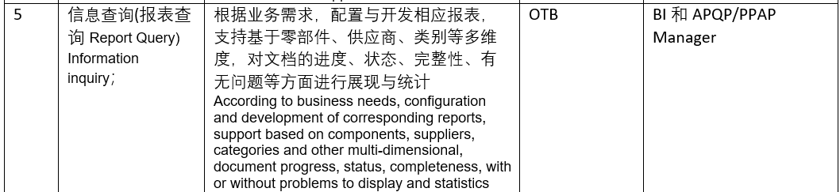
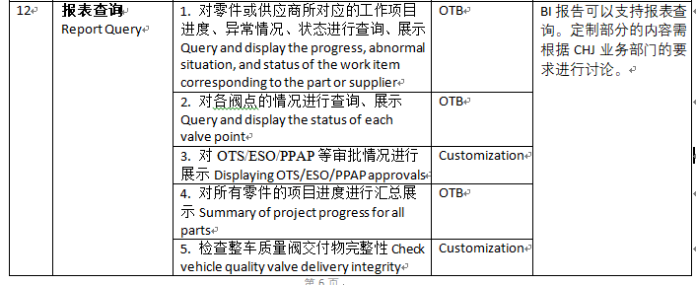

需求Requirement #5 & #12

Slide 28
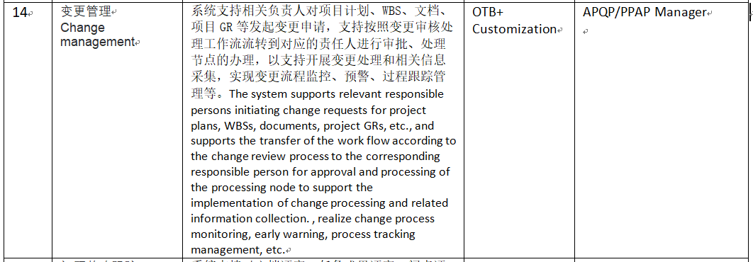
需求Requirement #14

Slide 29
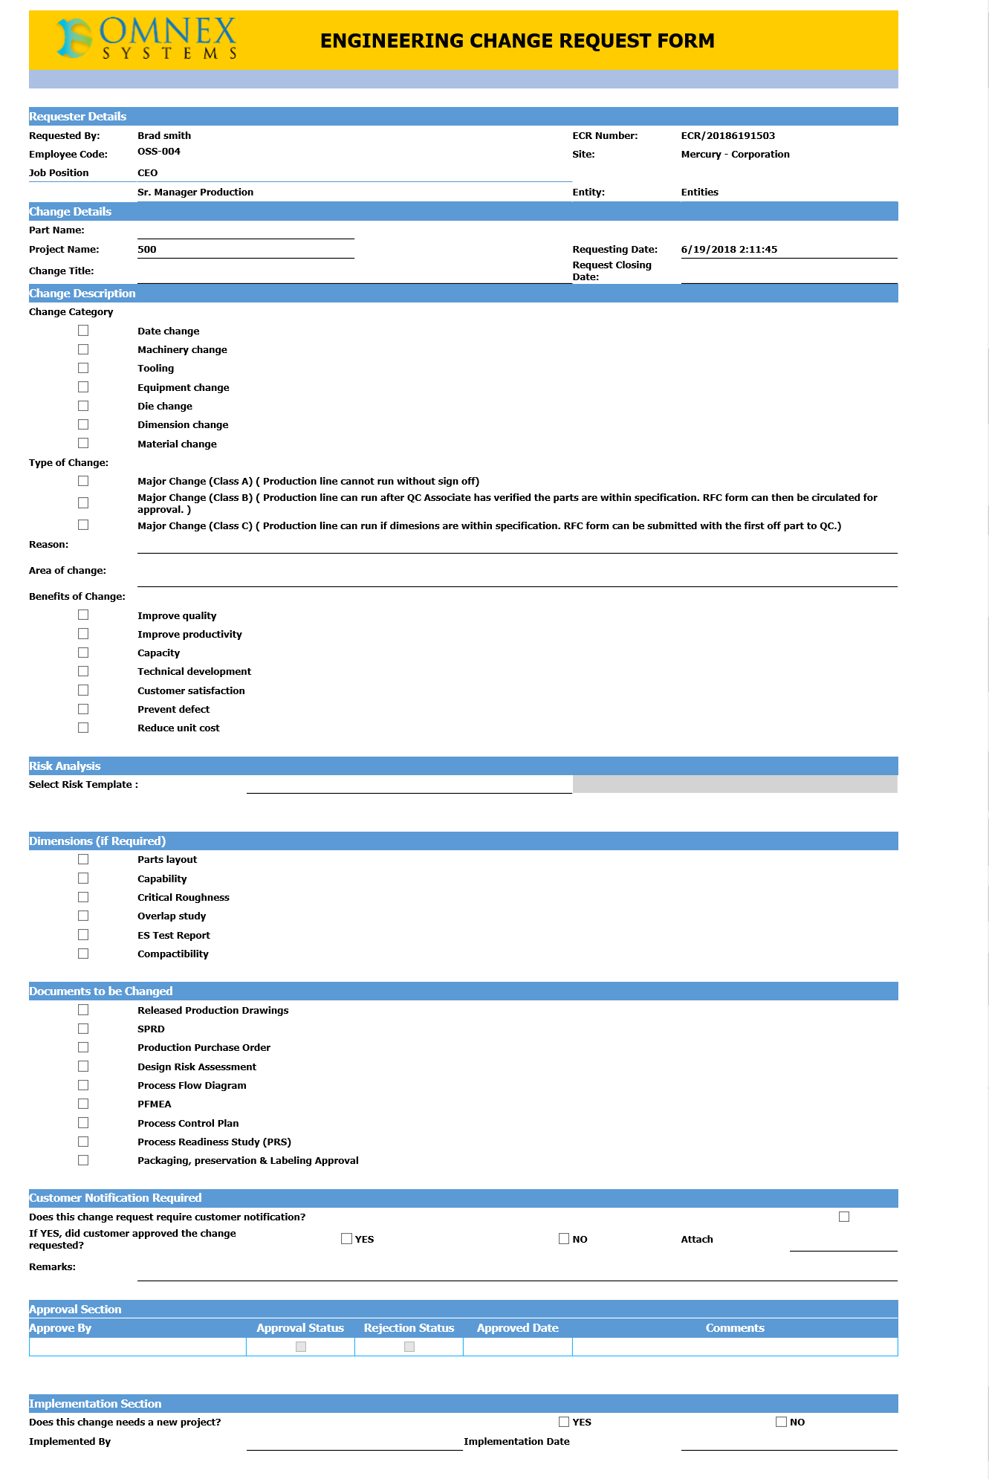
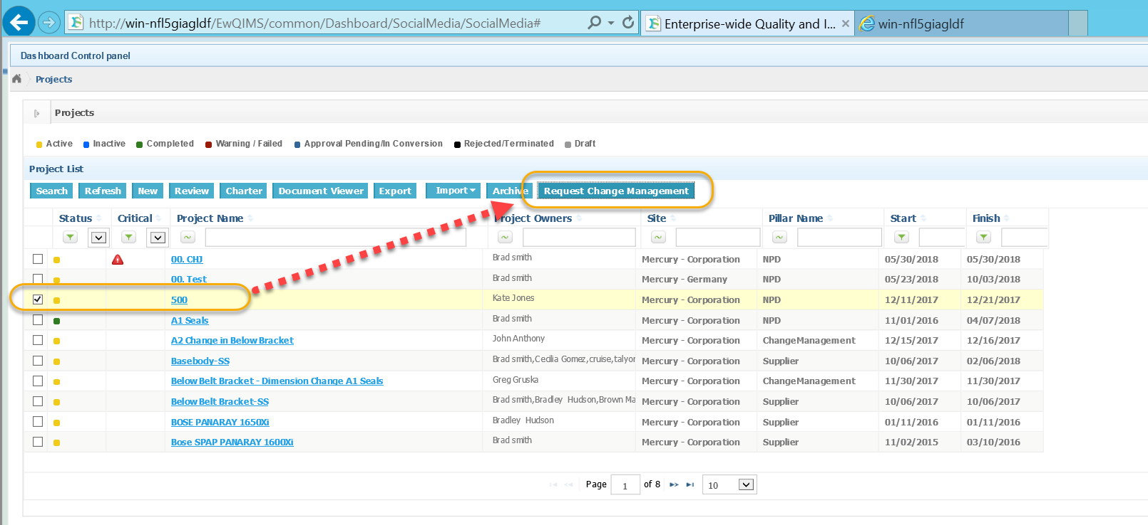

Slide 30
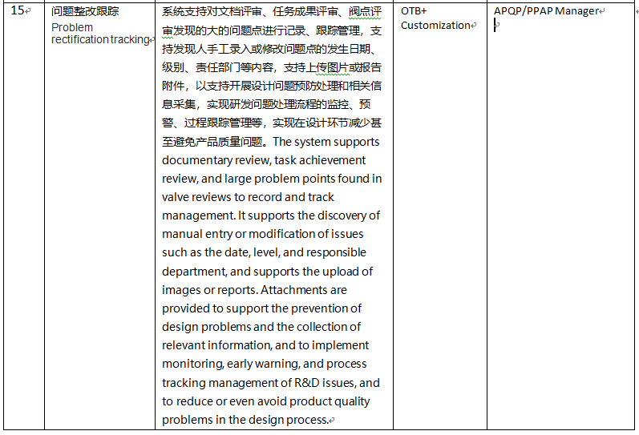
需求Requirement #14

Slide 31
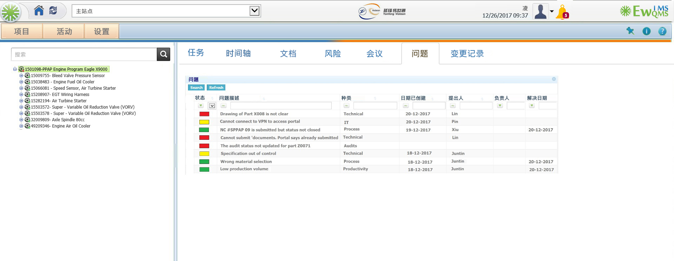


Slide 32
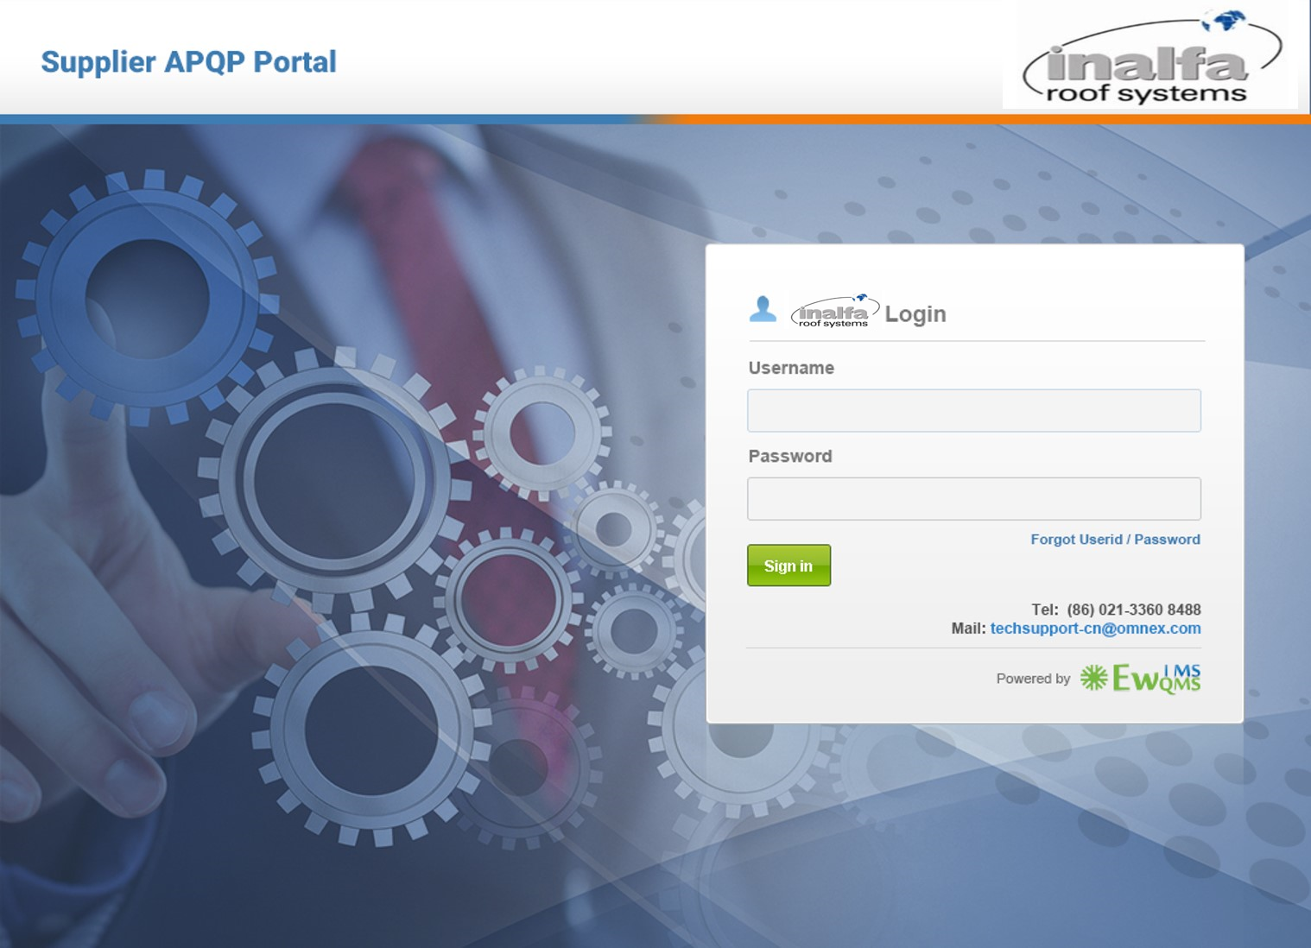

Slide 33

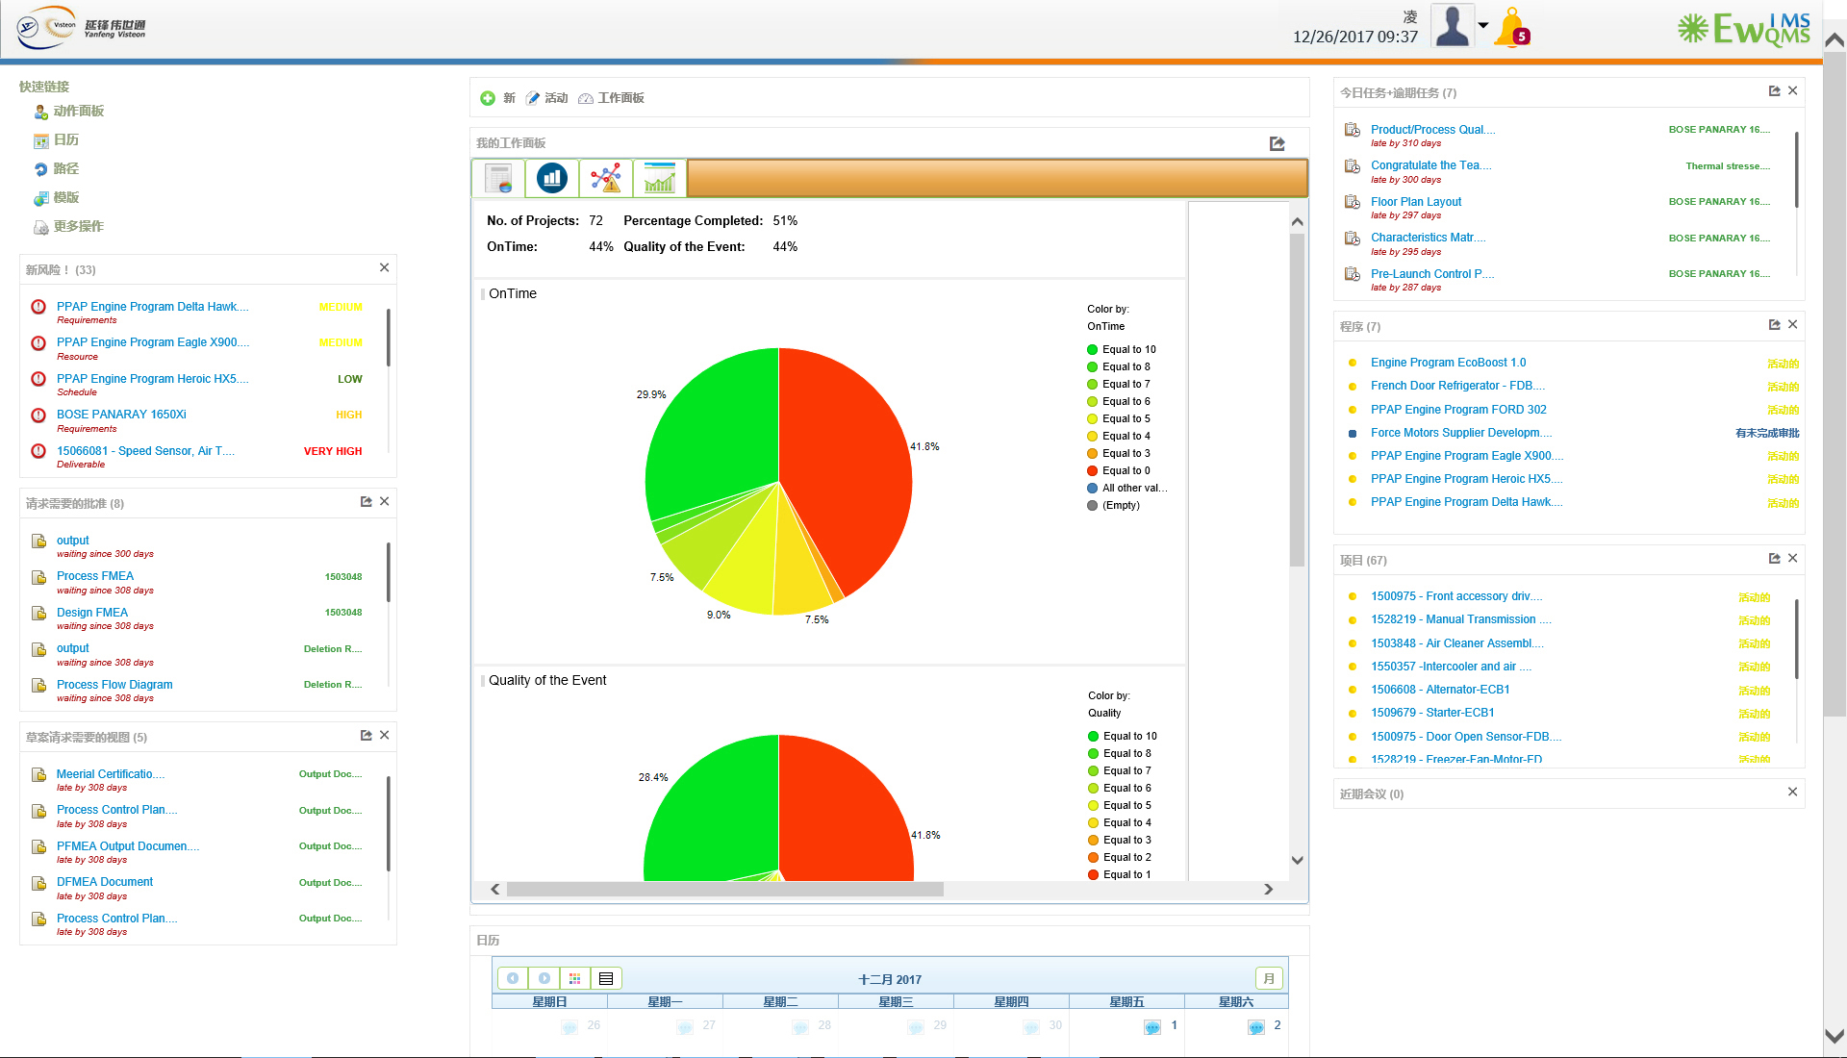

Slide 34
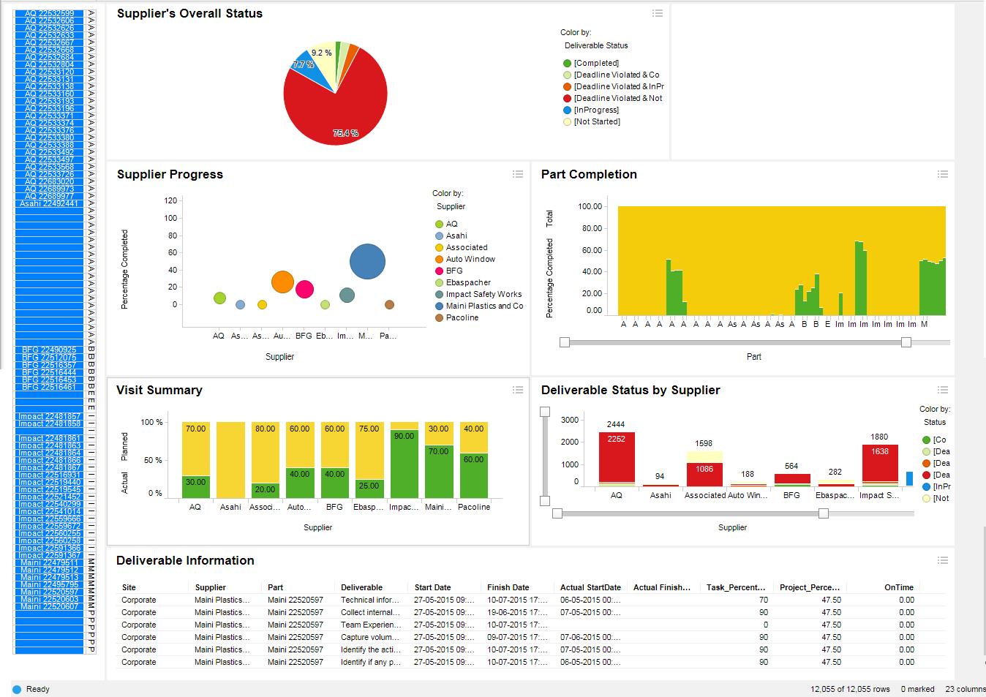
Supplier Dashboard / 供应商管理汇总表
v

Slide 35
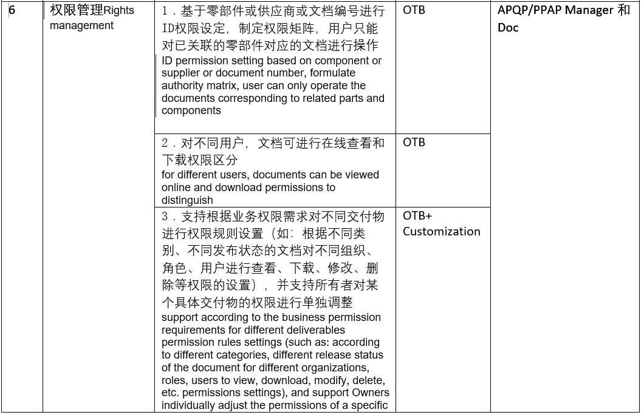
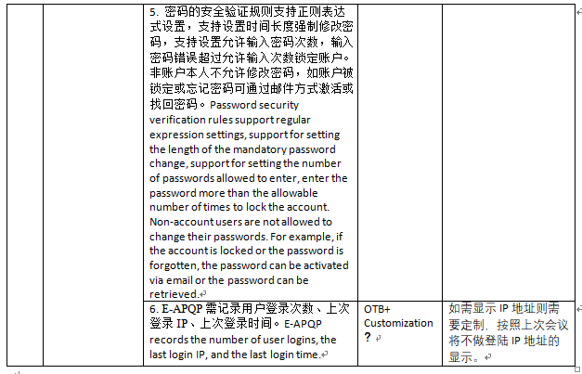
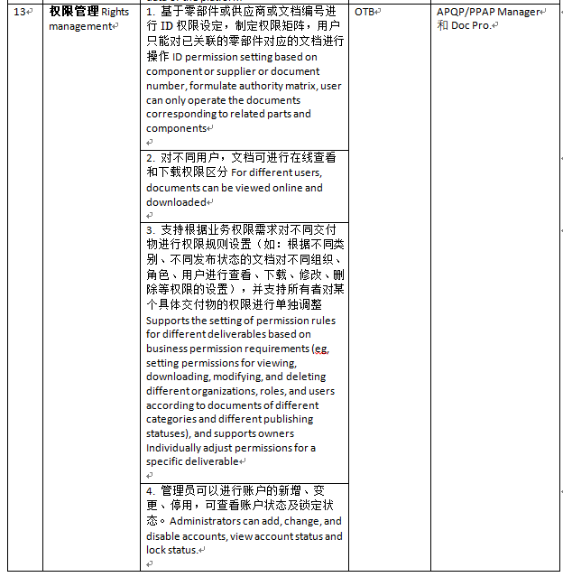
需求Requirement #6 & #13

Slide 36
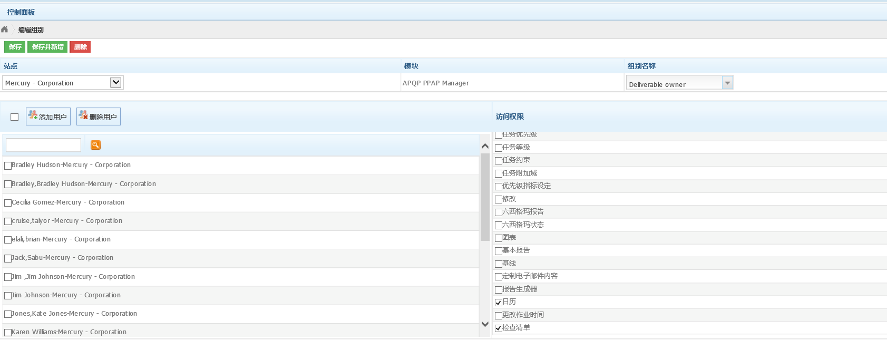

Slide 37
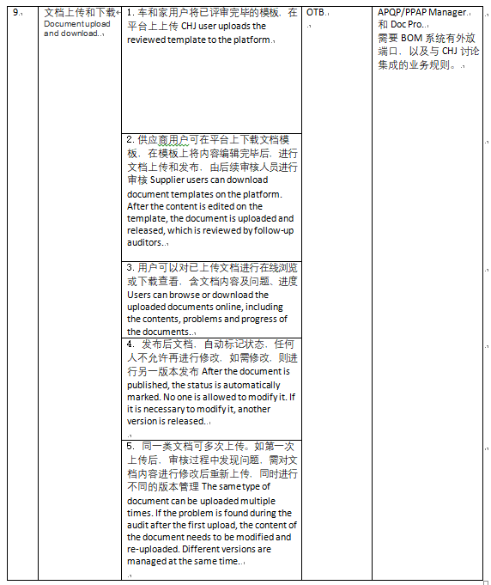
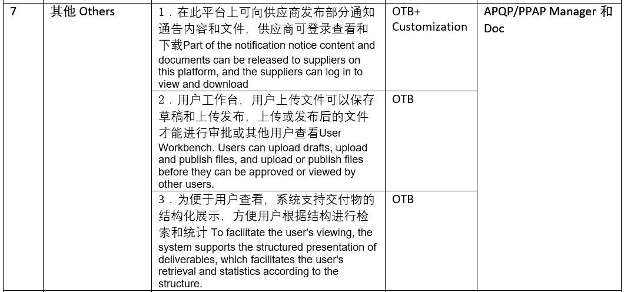
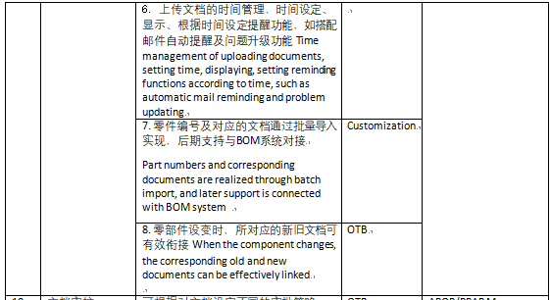
需求Requirement #7 & #9

Slide 38
Software Proposal/ 软件方案

Slide 39


CHJ – E-APQP
OMNEX Solution Proposed - Application Architecture
CHJ Internal User
Supplier Portal
CHJ APQP Modules
Supplier Modules
S
O
A
User Home Page, Supplier Management, APQP Program Management, Report Manager, Task Management, Issue Management, Document Management, Project Template Management, System Setup
Supplier Home Page, Supplier APQP/PPAP Program, Supplier Task, Supplier Issues, Supplier Actions, Supplier Document, Supplier News, Supplier Calendar
BOM SYS
Business Processes
Project Plan Release
Issue Management
Document Review
Supplier Document Release
Others
Components
Business Component
Workflow/Rules Engine
Document Repository
Program Template
Gate Review Checklist
Activity Directory Integration
SOA
(System Connectivity)
PPQP
Checklist
Project Deliverable Review Checklist
Database

Slide 40
OMNEX Solution Proposed - System Architecture
APQP
物流
Supplier Quality Management System
研发
System Setup
Supplier Management
Project Management
PTC
Issue/Risk Management
Report Management
Task Management
采购
Content Management
APQP/PPAP Program Management
Others(Mail, Notification…)
SUPPLIER
data
data
BOM Management system
SRM(Suppliers’ information)

Slide 41
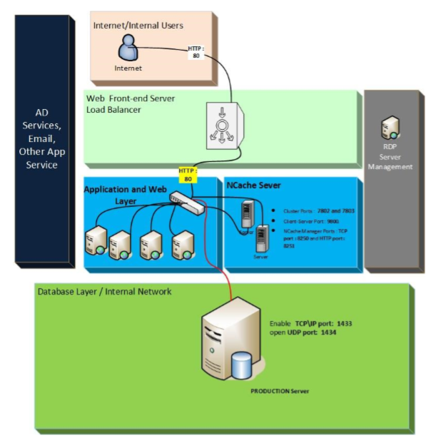
EwQIMS Deployment Architecture:

Slide 42
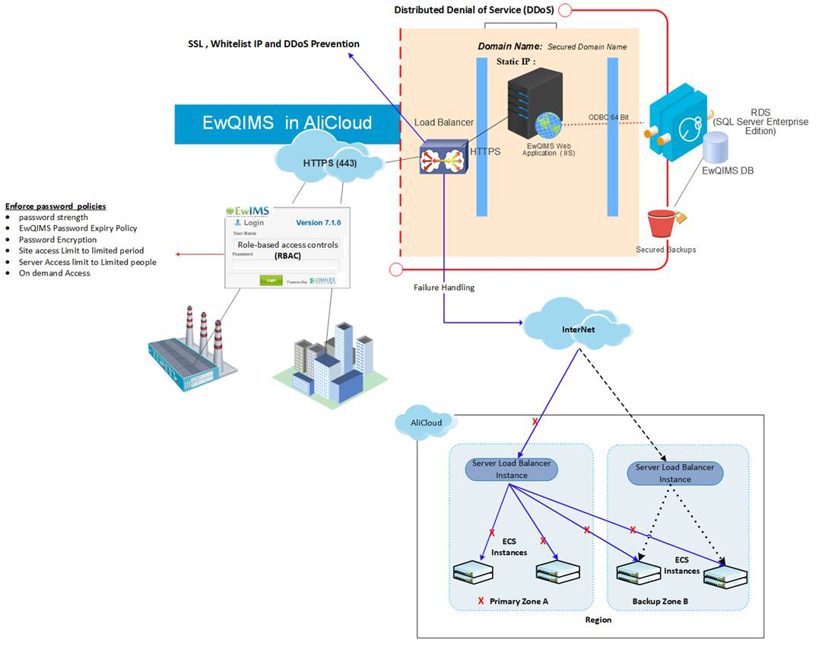
Solution Deployment on Cloud
Notes:
1, need a diagram to demonstrate the whole system’s infrastructure;
2, need to avoid the single point of failure in our design;
3, the suggested hardware configuration should be provided here(according to user’s usage situation);
Total users number will be 500 or more;
According to Li Zhuo’s estimation, the concurrent users at peak time will be 100-200,

Slide 43
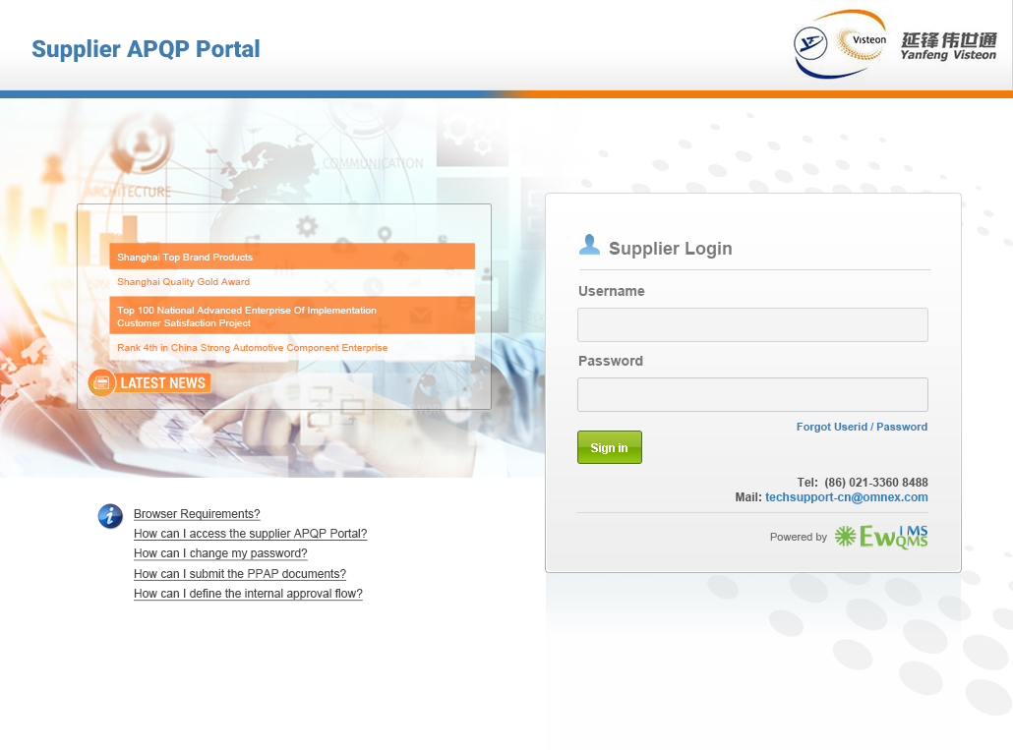


Slide 44
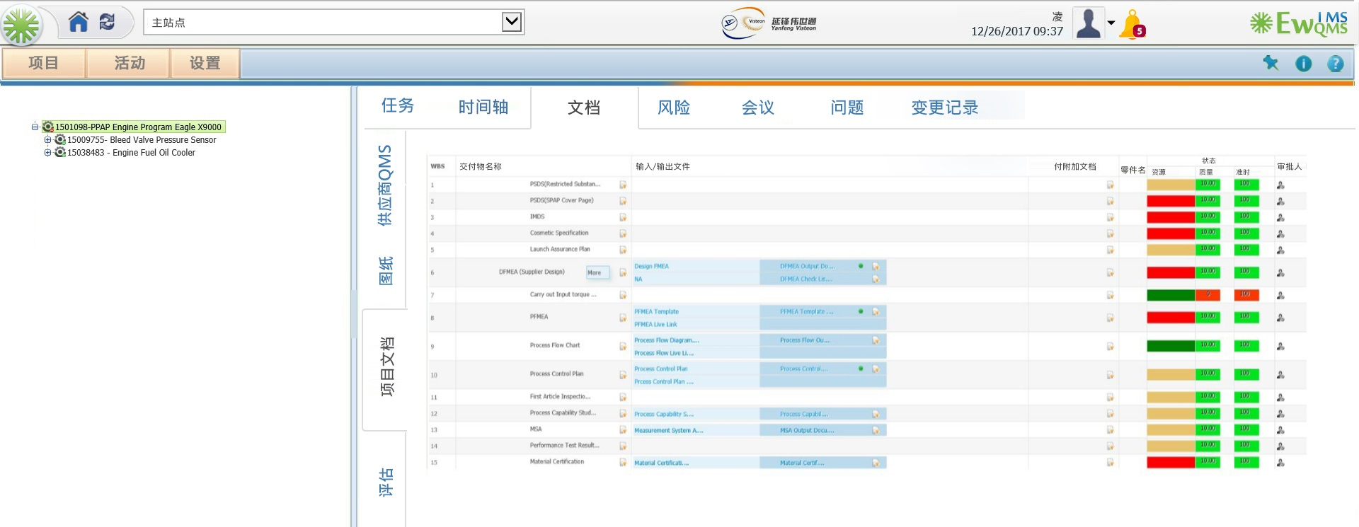

Slide 45

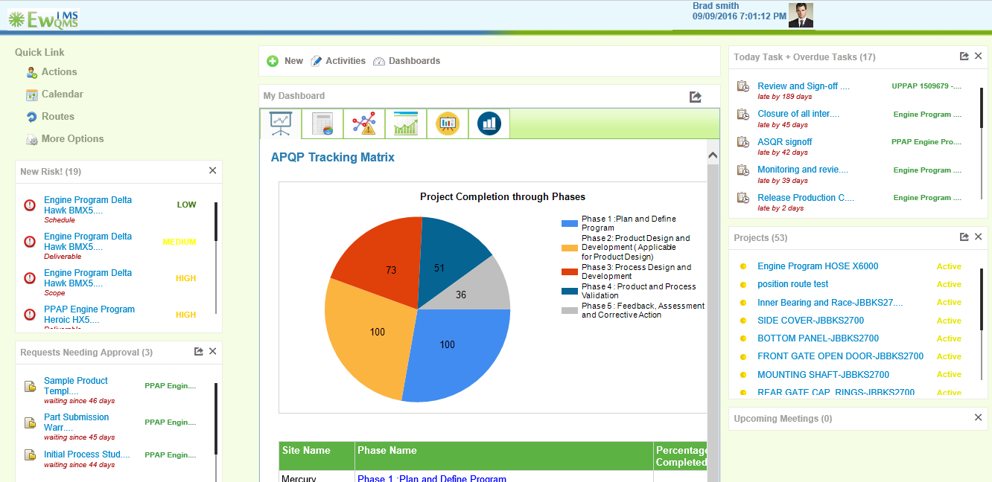
可配置的APQP工作面板 Configurable APQP Desktops
v

Slide 46
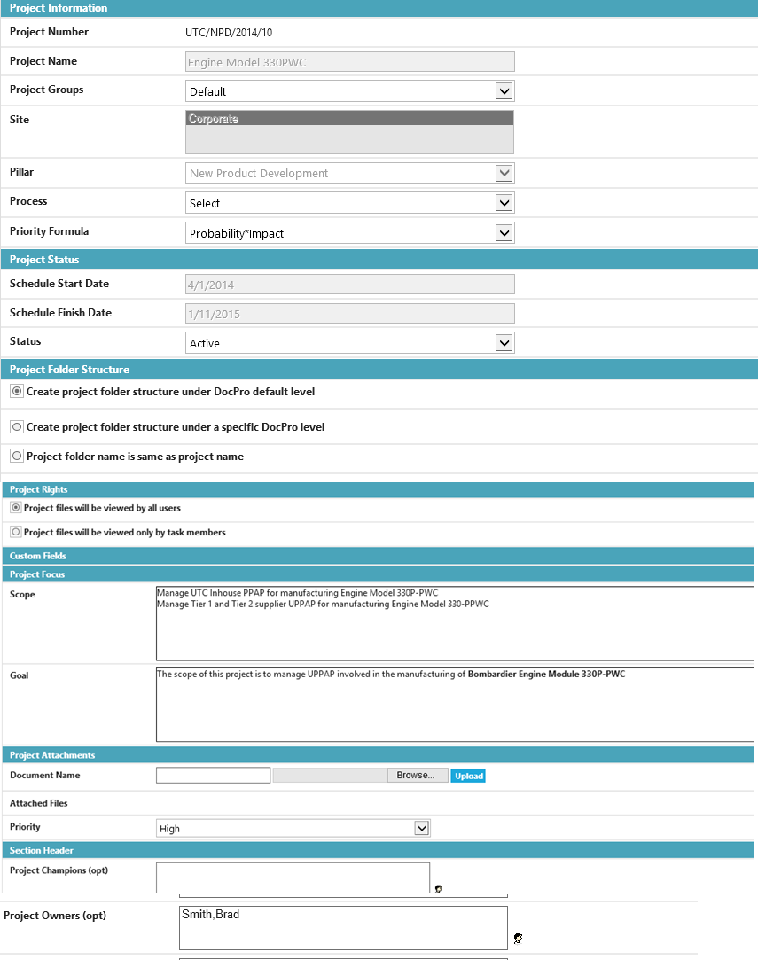
APQP章程 APQP Project Charter
v

Slide 47
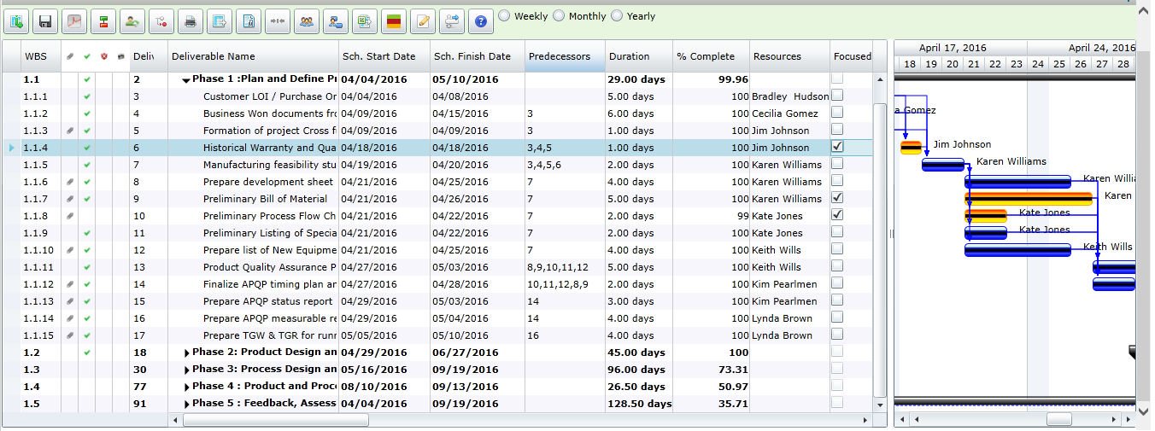
项目计划 APQP Project Plans
Focused Elements
Click on the Attachment icons to view the for each deliverable. This would include documents from AQuA Pro and MSA Pro
v

Slide 48
APQP计划-其他主要特点 APQP Planning - Other Key Features
Convert Project to Template
Meetings Manager
Focused Deliverable
Critical Path Management
Critical Path Management
On Line Project Reviews
Rich GUI to modify schedules, Predecessors with Mouse drag options
Establishing Project Baselines and notifying Baselines changes to the Project team
Compare Baseline & Actual Project status.
Calendar notifying you the scheduled tasks for a particular month
Change view of Gantt Chart
v

Slide 49
项目&交付物 APQP Project & Deliverable Attachments
v

Slide 50
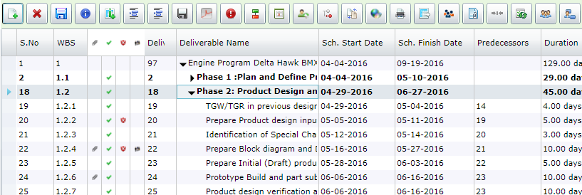
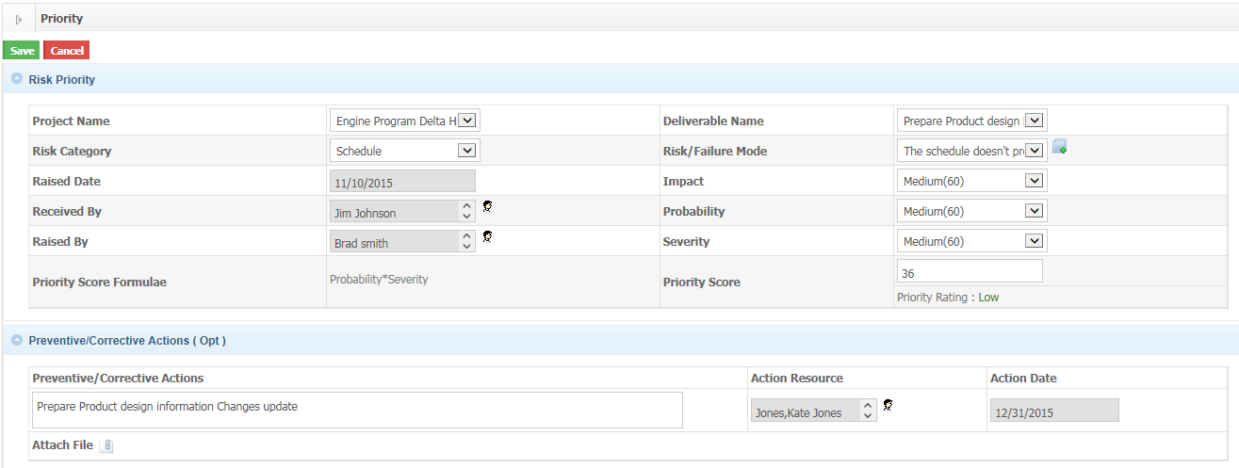
APQP风险管理 APQP Risk Management
v

Slide 51
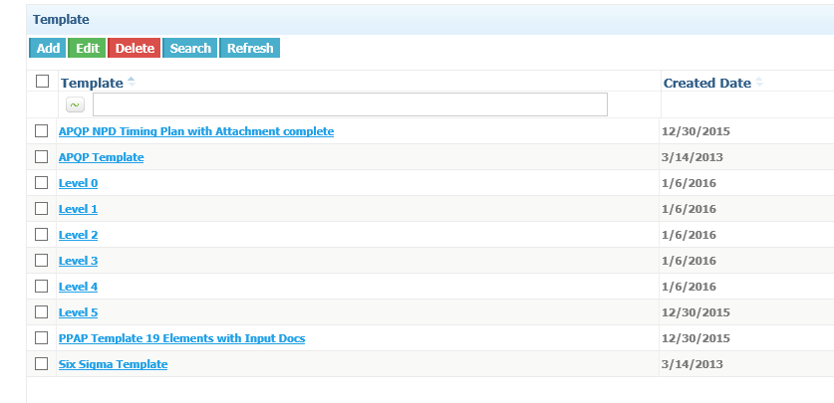
APQP&PPAP模板 Templates for APQP and PPAP
v

Slide 52
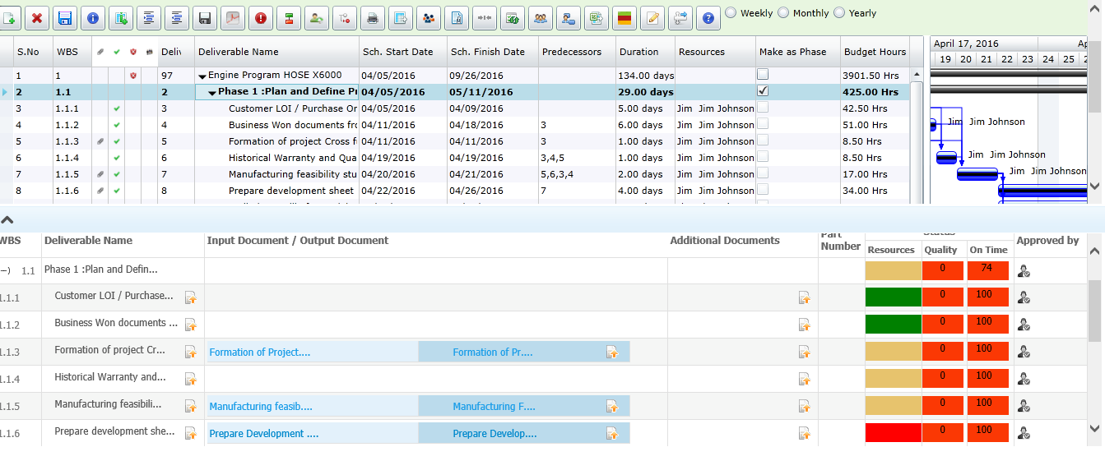
跟踪项目截止日期，文件，质量和资源Track Projects Deadlines, Documents, Quality & Resources

Slide 53
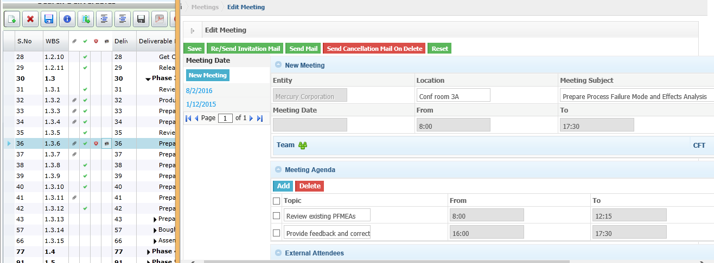
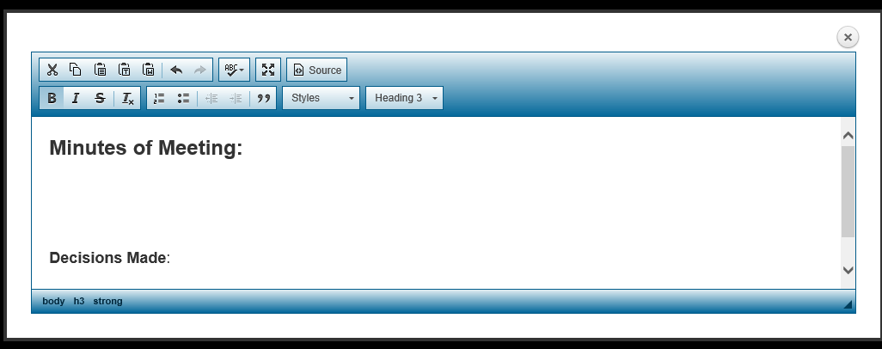

会议管理 Meetings Manager
v

Slide 54

文档查看器提供所有文档和状态的视图
Document Viewer Provides View of All Documents and Status
v

Slide 55

项目概要复查 Project Summary Reviews
v

Slide 56


项目状态更新 Update Project Status
v

Slide 57

MS 项目的导出 Export to MS Projects
v

Slide 58

APQP 跟踪矩阵 APQP Tracking Matrix
v

Slide 59

Resource Tracking
v

Slide 60

Resource Allocation
v

Slide 61

Risk Register
v

Slide 62

Project Implementation & Release

Slide 63
Implementation & Release Plan - Project Plan
2018
2019
Project milestone
Apr
May
Jun
Jul
Aug
Sep
Oct
Nov
Dec
Jan
Feb
Mar
Apr
May
Jun
需求理解
整体方案设计
需求调研和整理
系统搭建和研发
系统测试
上线和支持
June 28th, 2018
Nov 31st, 2018

Slide 64

Thank you / 谢谢

